Slide 1

‹#›
Notes:
‹#›

Slide 2
Applications call the LFS via system calls
LFS deals with file names, file and directory operations, file tables, security
FOM maps logical to physical, buffers, tracks free blocks, tracks bad blocks
BFS sends commands to DDs to access specified blocks on the device
I/O control consists of device drivers and interrupts handlers for each device.
Application programs
Logical file system
File Organization module
Basic file system
I/O Control
Devices
‹#›
Notes:
‹#›

Slide 3
File Organization and Access
‹#›

Slide 4
Def’n
File organization to refer to the logical structuring of records as determined by the way in which they are accessed.
Several criteria for choosing a file organization are:
1) Short access time
2) Ease of update
3) Economy of storage
4) Simple maintenance
5)Reliability

Slide 5
Types of file organization
1) The pile
2) The sequential file
3)The indexed sequential file
4) The indexed file
5) The direct or hashed file

Slide 6
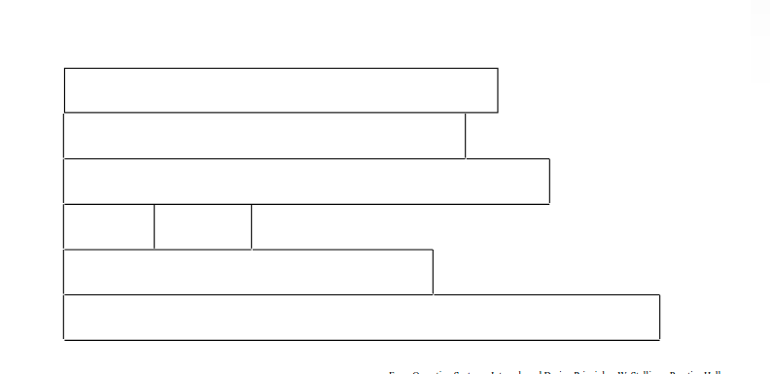
The Pile

Slide 7
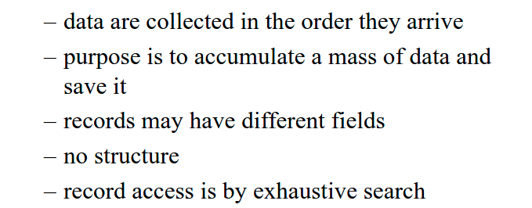
The Pile

Slide 8
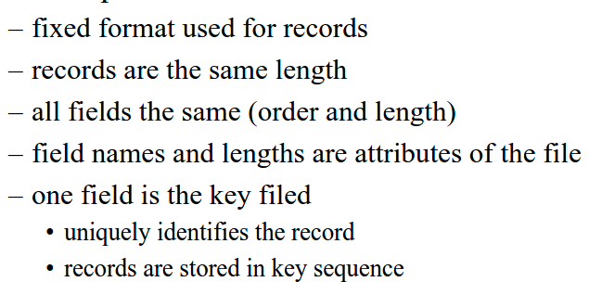
The Sequential file

Slide 9
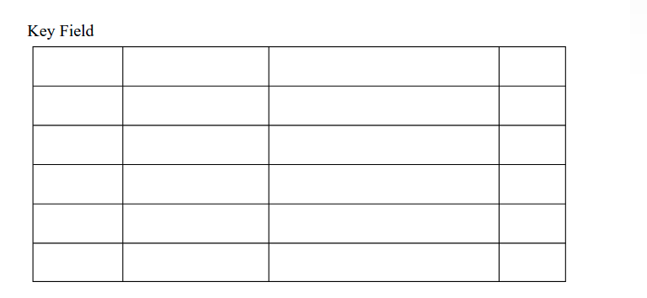
The Sequential file

Slide 10
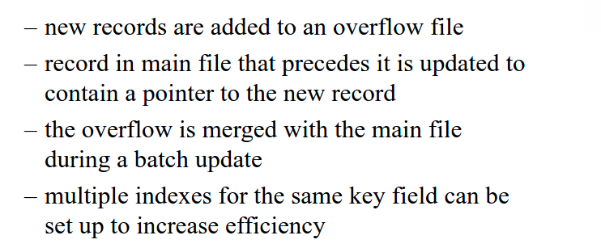
The Indexed Sequential file

Slide 11
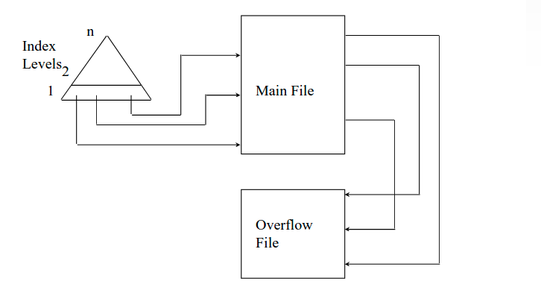

Slide 12
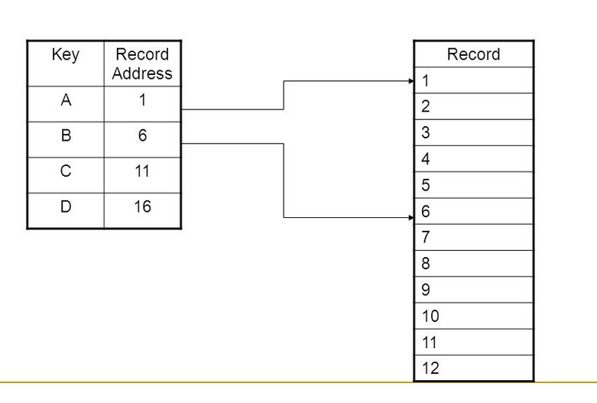

Slide 13
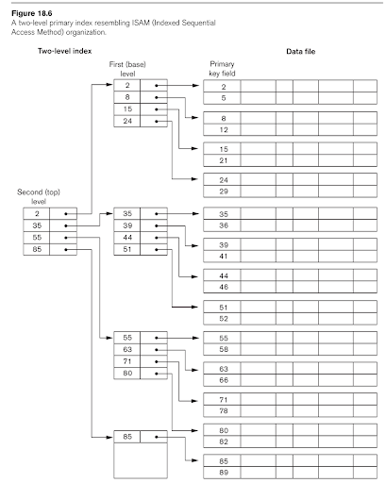

Slide 14
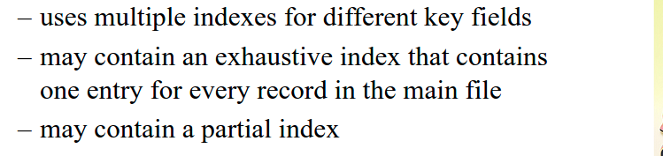
Indexed file

Slide 15
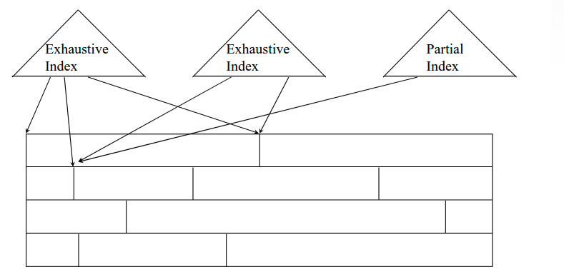
Indexed file

Slide 16
File Directories
1)Contents
2)Structure
3)Naming

Slide 17
File Directories
1)Contents:
The Directory contains the information about the files, including attributes, location and ownership.
Directory itself is a file accessible by various file management routines.

Slide 18
File Directories
1)Contents:
From Users point of view directory provides a mapping between file names known to users and application and files themselves.
Directory provides following details
1) Name of a file
2) Types of file and file organizations
3) Its storage location and size
4) For shared system, it provides access permissions and privileges
5) File usage information with date and time of creation of file and last modification

Slide 19
File Directory Contents
Basic Information : File name, File Type, File Organization
Address Information: Volume starting address size used and allocated.
Access Control Information: Owner, Access Information, Permitted actions
Usage Information: Date Created, Identity of creator, Date of last read access, Identity of last reader, Date of last modified, Identity of last modifier, Date of last backup and current usage.

Slide 20
Structure
The simplest form of structure for a directory is list of entries one for each file
But this is not efficient when if two files has same name in multiuser environment and even with single user with many files
Hence two level scheme is used,One directory for each user and a master directory
Master directory has an entry for each user directory and providing access control information.
Each user directory has contains a simple list of files with unique name with access restriction on files and directories
Tree structured directory approach is shown as in next as:

Slide 21
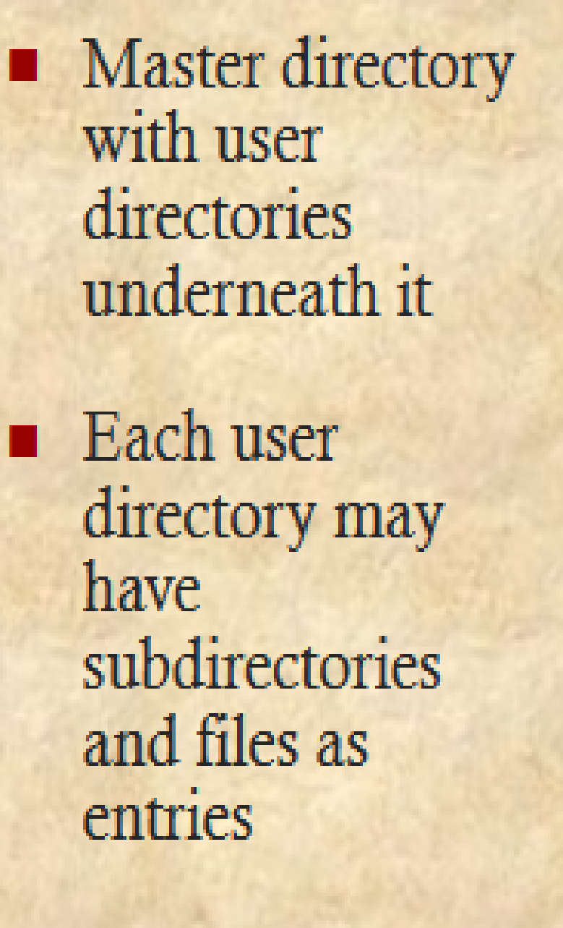
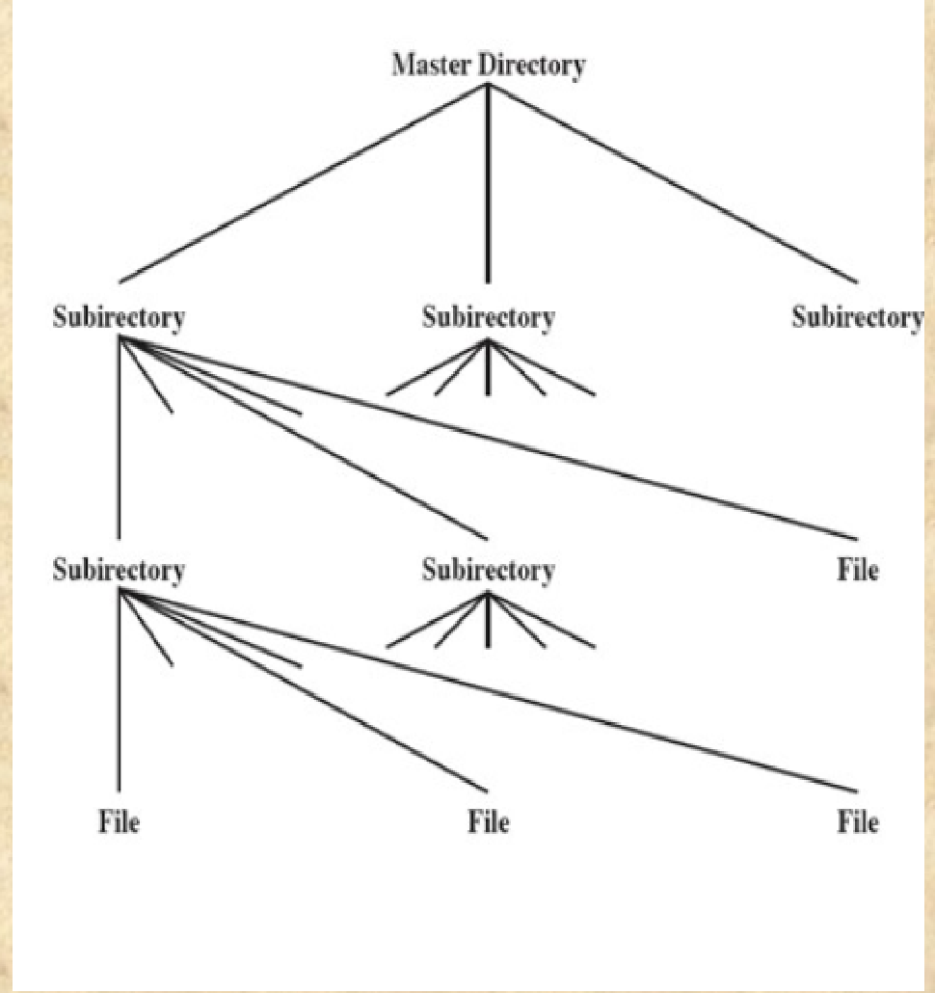
Tree structured directory

Slide 22
Naming
Users need to be able to refer to a file by symbolic name
Each file in the system must have a unique name in order that file references be unambiguous
Tree structured directory minimizes the difficulty in assigning unique names.
Any file is referred through the pathname.
/ is used to delimit names in the sequence

Slide 23
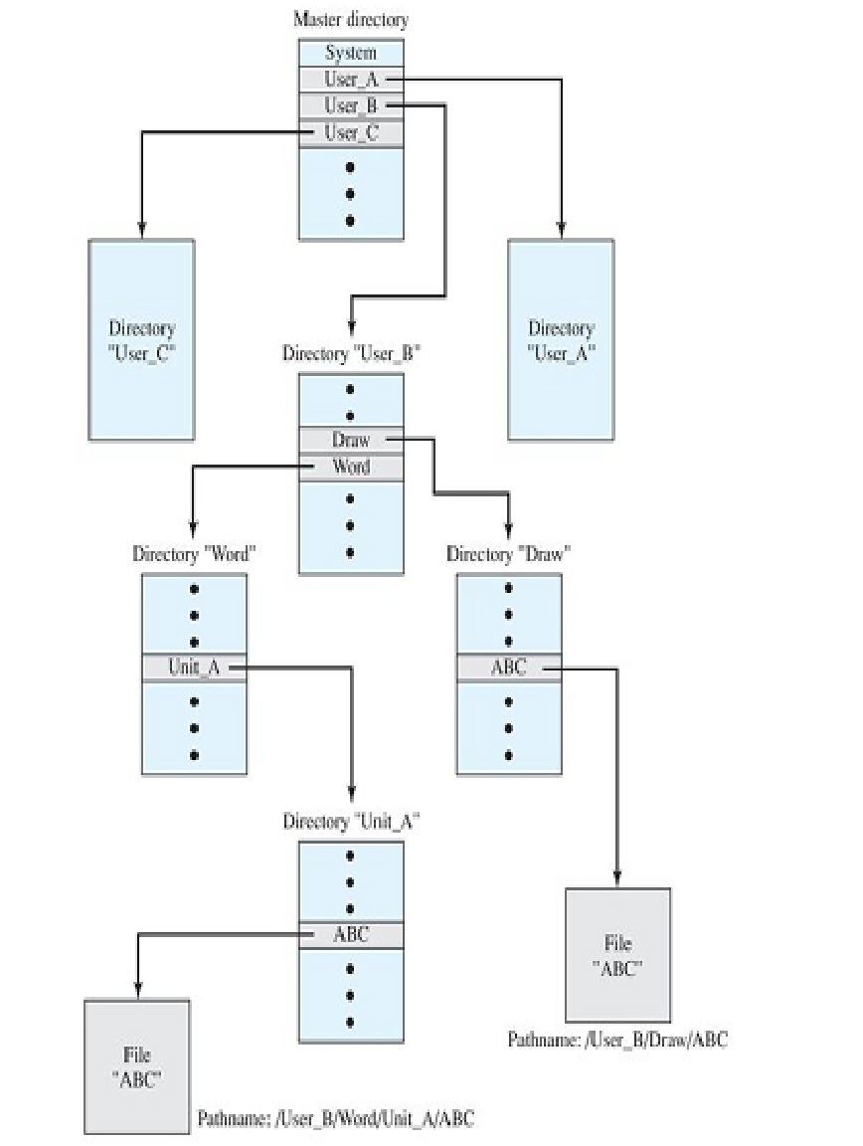
Ex :
There are files with same name ABC
Path1- User_B/Word/Unit_A/ABC
Path2 –
Unit_A/ABC
This example states three things
1)Master directory is compulsory in each path
2) Path2 is indicates working directory(Word) path of User B.
also called as relative pathname
3) Path1 indicates absolute pathname

Slide 24
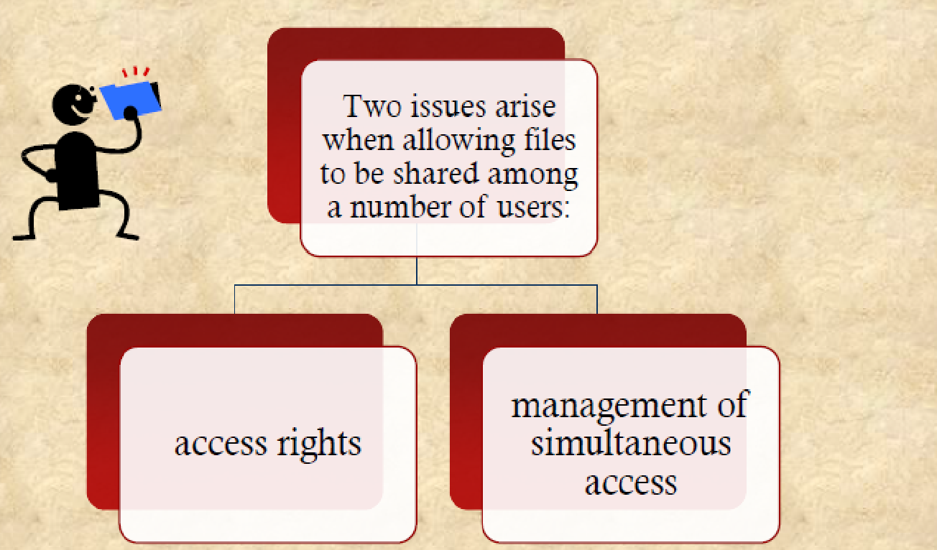
File sharing
Files to be shared among a no.of users.

Slide 25
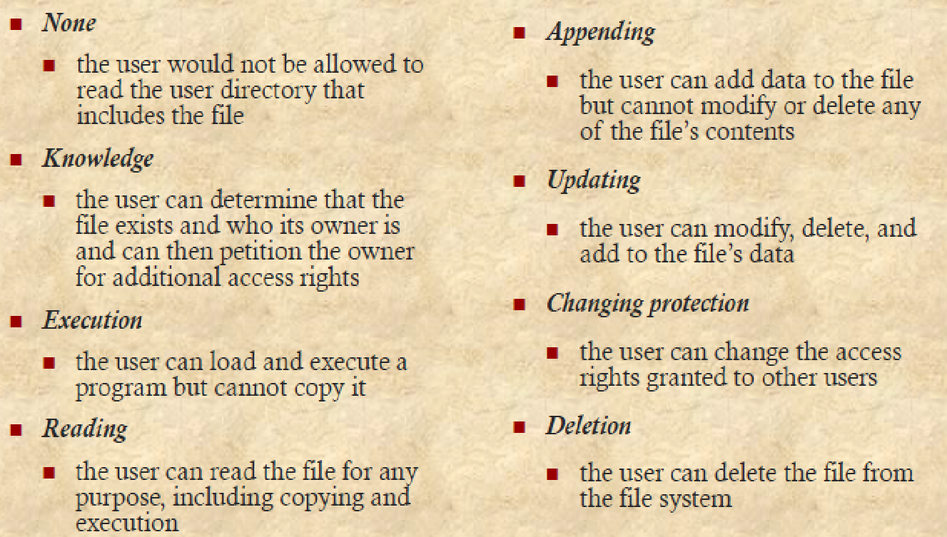
File sharing
Access rights:

Slide 26
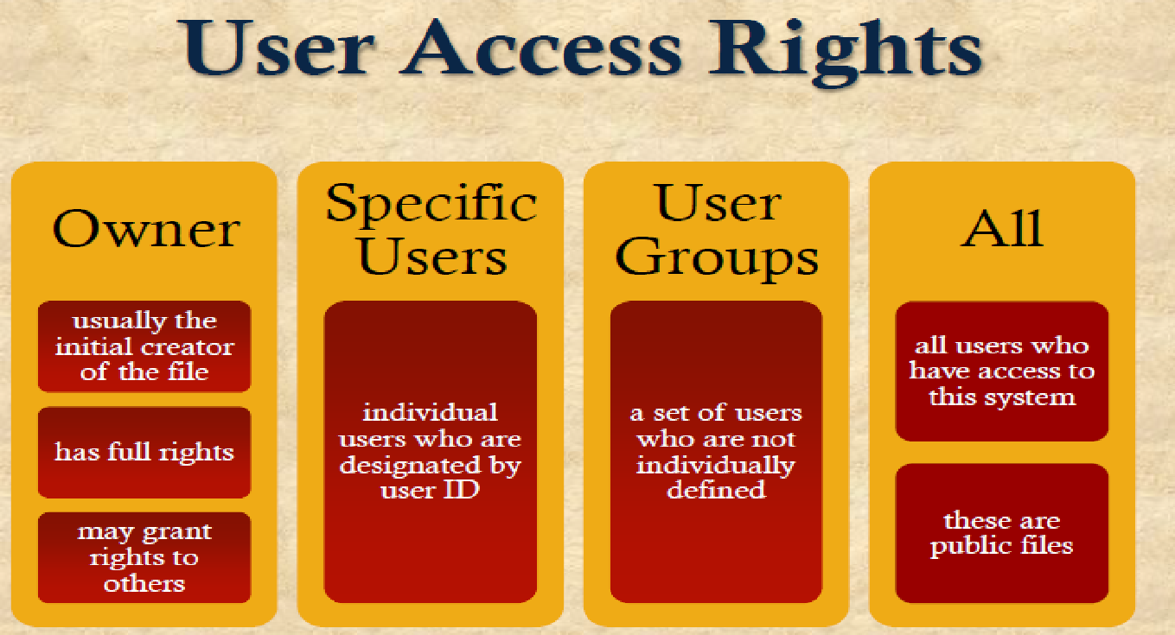
File sharing Contd..

Slide 27
File sharing Contd…
Simultaneous Access:
When access is granted to append or update a file to more than one user,
OS File management system must enforce locking mechanism either for entire file or or individual record during update
Plus
issues of mutual exclusion and deadlock must be addressed in designing the shared and simultaneous access capability

Slide 28

‹#›

Slide 29
OS is responsible for allocating blocks to a file.
Two management issues:
1.Space on secondary storage must be allocated to files.
2.To keep track with free space available .
1st issue File allocation
Preallocation Vs Dynamic allocation
2nd issue Portion size:
Two alternatives :
1) Variable, large contiguous portions
File allocation table size remain small
2) Blocks
File allocation table size remain large plus complex data structure.
3rd Issue is data structure used to keep track of portion assigned to a file
‹#›

Slide 30
File Allocation Methods:
Contiguous File Allocation
Linked File Allocation
Indexed File Allocation
‹#›

Slide 31
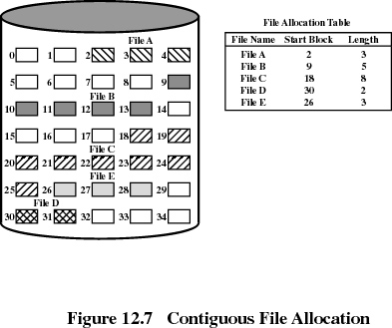

Useful for sequential files
Drawback:
External Fragmentation
Solution is compaction
‹#›
Notes:
‹#›
‹#›

Slide 32
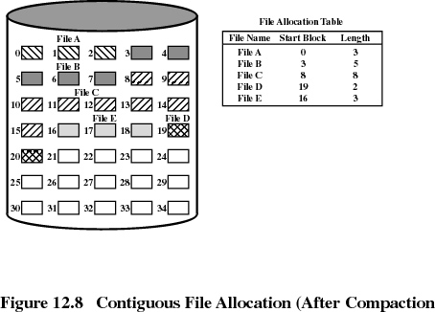
‹#›
Notes:
‹#›
‹#›

Slide 33
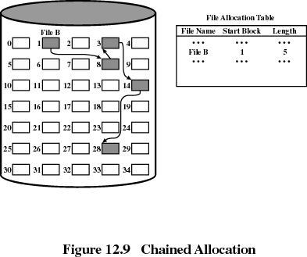
Useful for sequential files
Removes External Fragmentation
Drawback:Series of access to a different part of disk is inefficient
‹#›
Notes:
‹#›
‹#›

Slide 34
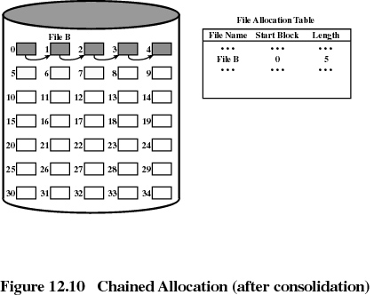
‹#›
Notes:
‹#›
‹#›

Slide 35

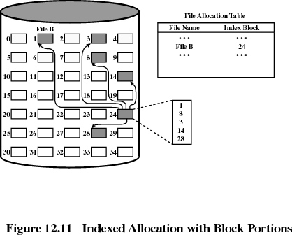
Indexed allocation
Each file has its own index block(s) of pointers to its data blocks
Supports sequential as well as Indexed file access & hence most popular
‹#›
Notes:
‹#›

Slide 36



